Slide 1
Software Presentation
Online Book Store

Slide 2
Software Requirement Specification

Slide 3
Scope
Online book store is designed to make purchase of books online.
It will allow users to search book under specific category and to purchase the same
The data will be held in the central database maintained by the store manager.
Further the store manager can add/update/remove the resources and users from the system
The tool would be cross platform as it is web based application

Slide 4
Feasibility
The Software is J2EE based. It was proposed to be made using Tomcat Apache web server and oracle database server
But use of oracle professional edition database server brings additional cost to my client hence microsoft access database server is used.Microsoft office is multipurpose package and ms-access provides multiple additional functionalities.
With proper documentation of Tomcat Apache web server available the product is technically feasible.

Slide 5
Functional Requirements
Features are:
Users
Can view the different categories of books available in the store
Can view the List of books available in each category
Can own an account in the site
Can purchase book
Can search other book in google book search available at the site

Slide 6
Risks
Scope Expansion : There would be no scope expansion as the software is restricted to J2EE platform , they all have same capabilities with standard architectures.
Enhancement can be thought in future.

Slide 7
Non-functional requirements
These are the constraints
Server Side:
Operating System: Windows 9x/xp ,Windows ME
Processor: Pentium 2.0 GHz or higher
RAM: 256 Mb or more
Hard Drive: 20 GB or more
Database: MS-Access database .
Web Server: Tomcat Apache Web Server
Client side:
Operating System: Windows 9x or above, MAC or UNIX.
Processor: Pentium III or 2.0 GHz or higher.
RAM: 256 Mb or more

Slide 8
Goals of Implementation
The project aims to
  Reduce the effort of visiting of book shop
  Home delivery of books
  To sell more books as another option of markting came into picture
  Commericially worthwhile
  Ease of book lovers

Slide 9
Decision Table
Conditions
Valid Selection | No | Yes | Yes | Yes | No
Shopping Chosen | - | Yes | Yes | Yes | No
Book Chosen | - | No | Yes | Yes | No
Valid username and password | - | - | - | Yes | -
New Member | - | - | - | - | Yes
 |  |  |  |  | -
Actions
Allow to shop | - | X | X | X | -
Display book list | - | - | X | X | -
Display Error | X | - | - | - | -
Build cutomer record | - | - | - | - | X
Generate Bill | - | - | - | X | -

Slide 10
DFD

Slide 11
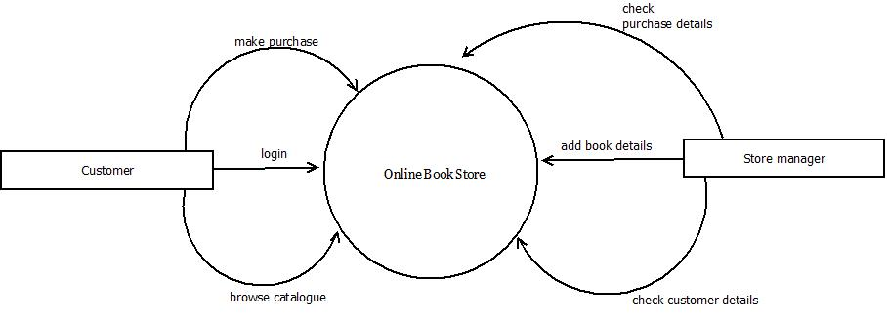
Level 0

Slide 12
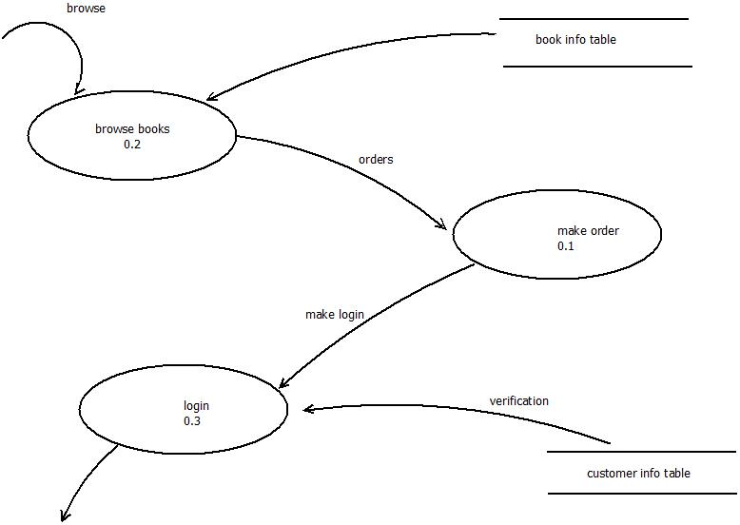
Level 1

Slide 13
Structure Chart

Slide 14
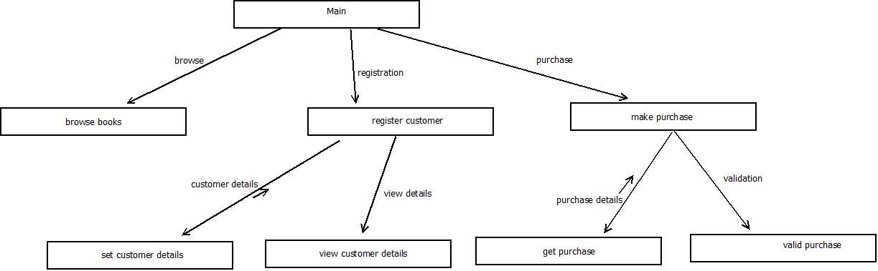

Slide 15
Use Case Diagram

Slide 16
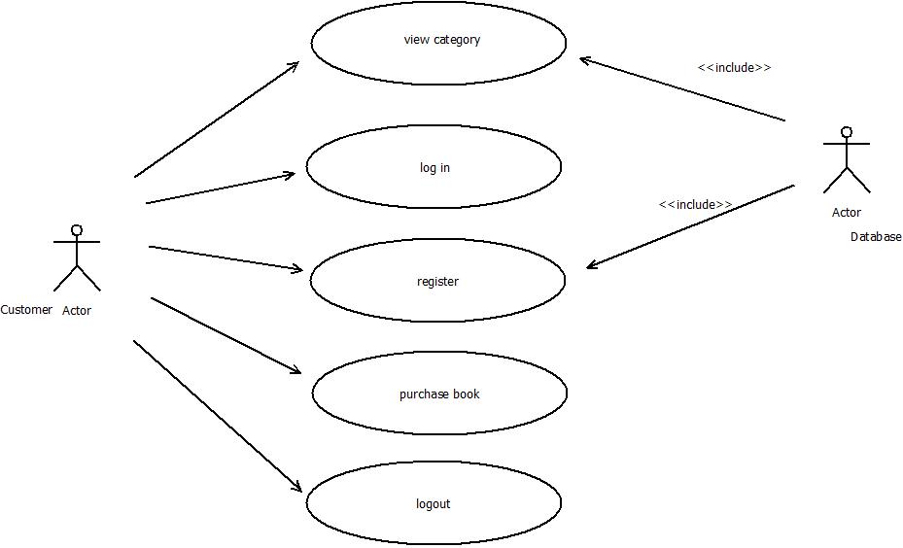

Slide 17
ClassDiagram

Slide 18
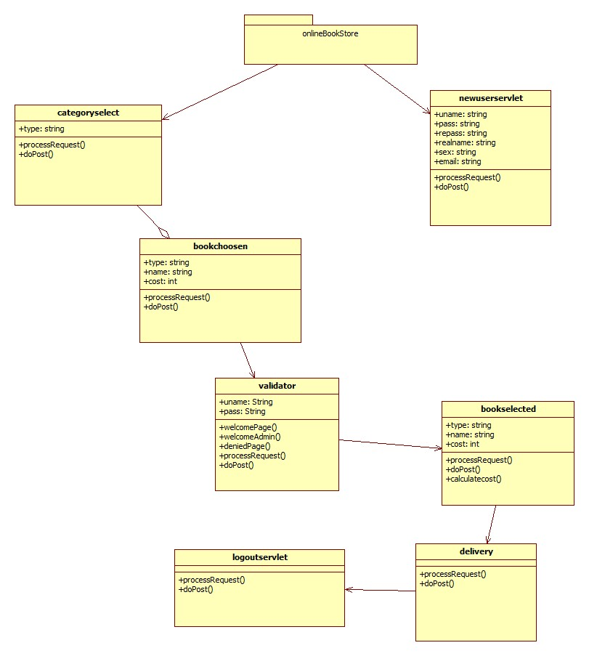

Slide 19
Collaboration Diagram
1 :choosen books can be purchased or not
:bookchoosen
:validator
2:Return status

Slide 20
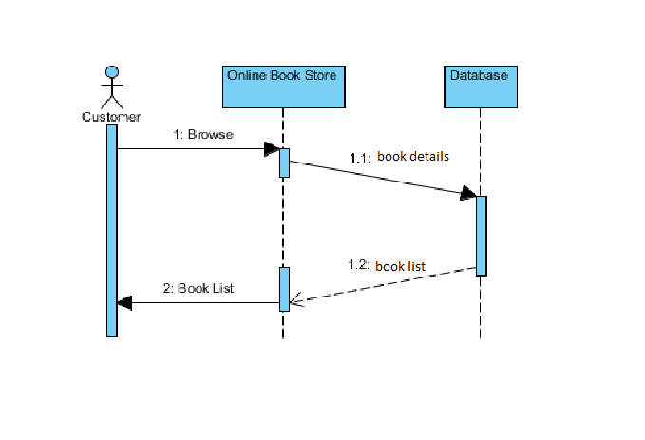
Basic Sequence Diagram

Slide 21
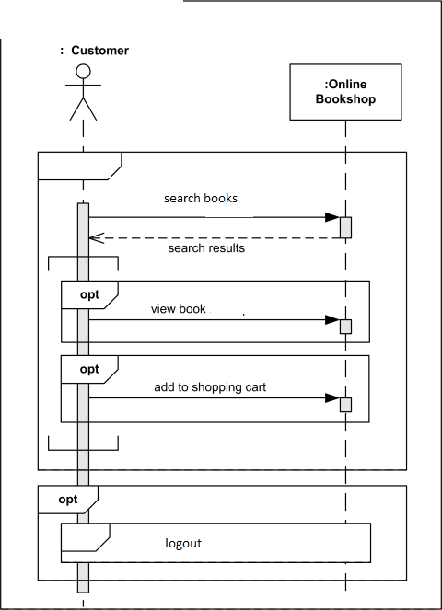

Slide 22
Activity Diagram
obs
database
browse books
Book list
View book list

Slide 23
Activity Diagram
Obs
database
login
Check authentication
purchase book
Invalid user

Slide 24
State Chart
Option Choosen
Browse books
Return BookList

Slide 25
State Chart
login
validate
Redirect accordingly

Slide 26
Details of Functional Approach
The Software in Functional Approach has been implemented.
All the modules are implemented in a single Class in J2EE.

Slide 27
Details of Object Oriented Approach
The Software in Oriented Approach has been implemented.
All the modules are implemented in a 7 Classes in J2EE.
They are:
Bookchoosen
Bookselected
Categoryselect
Delivery
Logoutservlet
Newuserservlet
validator

Slide 28
The Real/Actual Implementation
The final implementation is Object oriented .
The class validator use to authenticate user.
Class bookchoosen to choose book
Object Oriented approach has code easy to debug.

Slide 29
Thank you

